Slide 1
Windows Security
By Anna and Seamus

Slide 2
Agenda
Windows Internals
Registry
LSA
SAM
Active Directory basics
stuff
Group Policy
Security concerns

Slide 3
The Windows Registry
A hierarchical key-value store, with 5 root keys
HKLM - Computer Specific
HKCC - Runtime Information
HKCU - Information specific to currently logged in user
HKCR - Information for applications
HKU - all users
HKEY_PERF_DATA
Not stored as a standard hive
How the performance subsystem is implemented

Slide 4
Local Security Authority (LSA)
Windows subsystem responsible for managing authentication and local security policy
Local security policy determines:
Which users can access the system and in what way
Which users have which permissions on the system
What forms of auditing are being performed

Slide 5
Security Accounts Manager (SAM)
Database that stores users’ password hashes
Two password hashing algorithms have been used
Lan Manager (LM) hash
NT (NTLM) hash
On most modern Windows OS versions, the SAM file is encrypted to prevent password cracking

Slide 6
Directory Services
A Directory Service maps a network resource (applications, services, printers, computers, users) to a network address
DNS can be considered a directory service
Many different directory servers out there - IBM, Oracle, Microsoft implemented proprietary ones, as well as open source alternatives

Slide 7
LDAP!
Open, vendor neutral protocol for accessing directory services
Originally an alternative to X.500 for the TCP/IP protocol suite
In Plain English: “Search in the company email directory for all people located in Nashville, whose name contains “Bob”, return their full name, title, email, and description”

Slide 8
Active Directory
“Active Directory…keeps track of your user accounts and passwords, storing them in one protected location, improving your users security”
“An LDAP enabled database with LDAP dependent applications and services on top of it such as DNS, kerberos, etc”
“...a centralized and standardized system that automates network management of user data, security, and distributed resources…”

Slide 9
...but what is it really?
A distributed, Jet database
Directory System Agent (DSA)
LDAP
ADSI
SAM
Jet makes it fast, DSA gives it LDAP

Slide 10
AD on Disk
NTDS.dit
SYSVOL
Group Policies
Logon scripts
Folders to sync data between DC’s
NETLOGON
Symlink to logon scripts in \SYSVOL

Slide 11
Domain Admin
Full control of the domain and everything in it
Admin on the Domain Controllers
Admin on all workstations
Admin on all servers
Everything

Slide 12
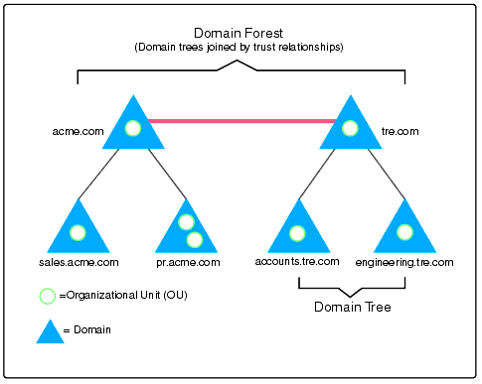

Slide 13
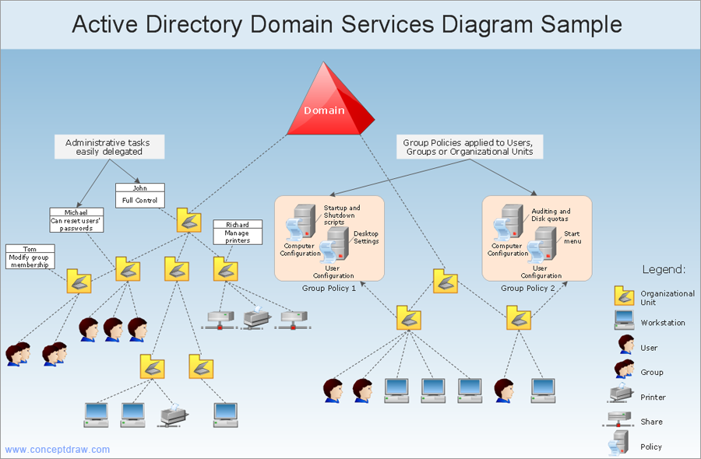

Slide 14
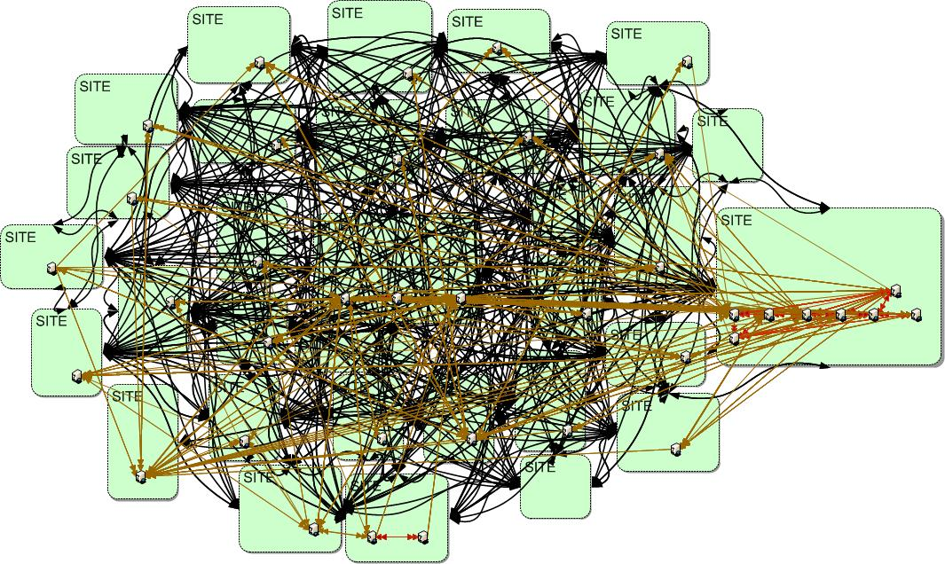

Slide 15
Group Policy
GP provides centralized management and configuration of the OS and applications’ settings
A set of configurations is grouped into a Group Policy Object (GPO)
AD can distribute GPOs to computers in the domain
Every computer pulls the policy every 90 minutes and checks for updates
Really powerful for enforcing desired state across multiple computers

Slide 16
Kerberos
Authentication protocol, uses “tickets” to allow users to authenticate to each other, establish trust about who you are talking to
MIT developed it, open source
Used everywhere
BSD
OS X
Solaris
HP-UX
Windows
Linux

Slide 17
Microsoft Kerberos
KDC - Key Distribution Center - the service which supplies the keys.
krbtgt - the user account which runs the KDC
TGT - Ticket Granting Ticket
Represents the user after being authenticated
Can derive other tickets from this, for services and stuff
Stays valid for ~10 hours
Encrypted and signed by krbtgt key!!!

Slide 18
Attacking the Domain
There are two major ways to move around a domain
Attack NTLM
Pass hashes
Attack Kerberos
Golden/silver tickets

